Slide 1
Memory Bandwidth Management for Enhanced Throughput and Security in GPUs
Adwait Jog
Assistant Professor of Computer Science
College of William & Mary
http://adwaitjog.github.io/

Slide 2
William & Mary
Second oldest-institution of higher education in the US
Located in Williamsburg, VA. Recently hosted ASPLOS.
I am affiliated with Computer Science Department
Graduate Program (~65-70 Ph.D. students)
25 Faculty Members
Many graduated Ph.D. students have successfully established careers in academia & industry.

Slide 3
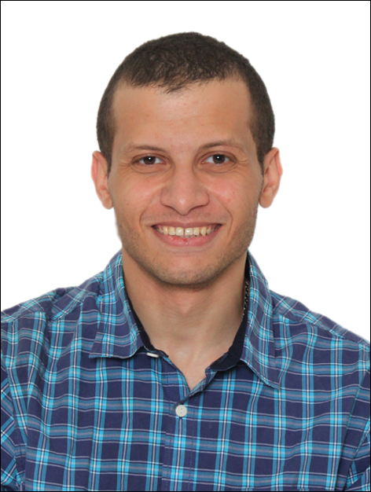
Insight Computer Architecture Lab
Mohamed Ibrahim (Ph.D. Student)
Gurunath Kadam
(Ph.D. student)
Hongyuan Liu
(Ph.D. student)
Haonan Wang
(Ph.D. student)
Fan Luo
(MS student, graduated)
Major Funding Source:
National Science Foundation
NSF CAREER (’18--)
NSF CORE (’17--)
NSF CRII (’17--)
Adwait Jog
(Faculty)
More details: http://insight-archlab.github.io/

Slide 4
Current Research Interests
We are computer architects
Architecting Graphics Processing Units (GPUs) and other accelerators of the future
GPU Security and Reliability
Non-traditional architectures (e.g., Automata Processors)

Slide 5
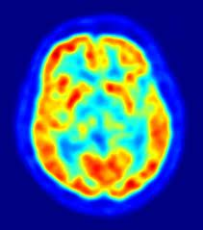
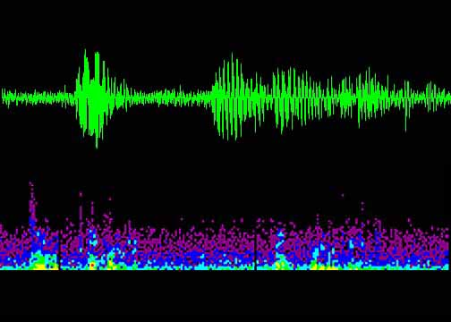
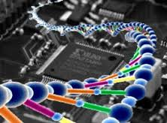
Why GPUs?
Astronomy
Medical
Imaging
Physics
Simulation
Audio
Processing
Machine
Learning
Data-Level Parallelism
Large
Data Sets
Image Processing
Financial Computing
Genomics
Games

Slide 6
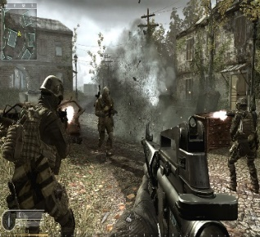
Why GPUs?
Applications
GPU
General-purpose Computing
on GPUs (GPGPUs)
Large Number of Cores

Slide 7
How Acceleration Works
Application Code
Sequential Code
Parallel Code
Sequential Code
Accelerator
(e.g., GPU)
Many supercomputers
in the green500 list employ accelerators.
Fewer Cores
Large Number of Cores
Optimized for Latency
Optimized for Throughput
Great for Sequential Code
Great for
Parallel Code
Notes:
Do not use the word “offload”

Slide 8
SUMMIT Super Computer
Multiple Volta GPUs
NVLink
HBM + DDR4
https://www.olcf.ornl.gov/olcf-resources/compute-systems/summit/

Slide 9
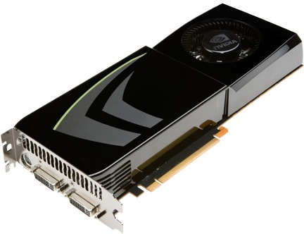
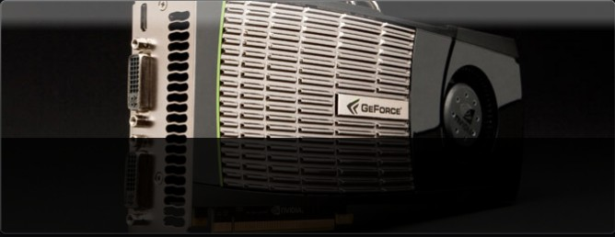
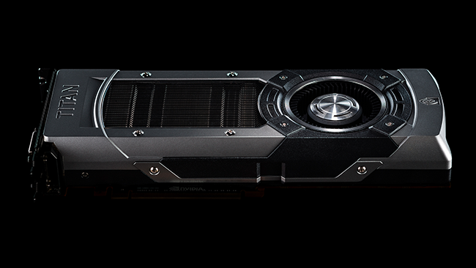
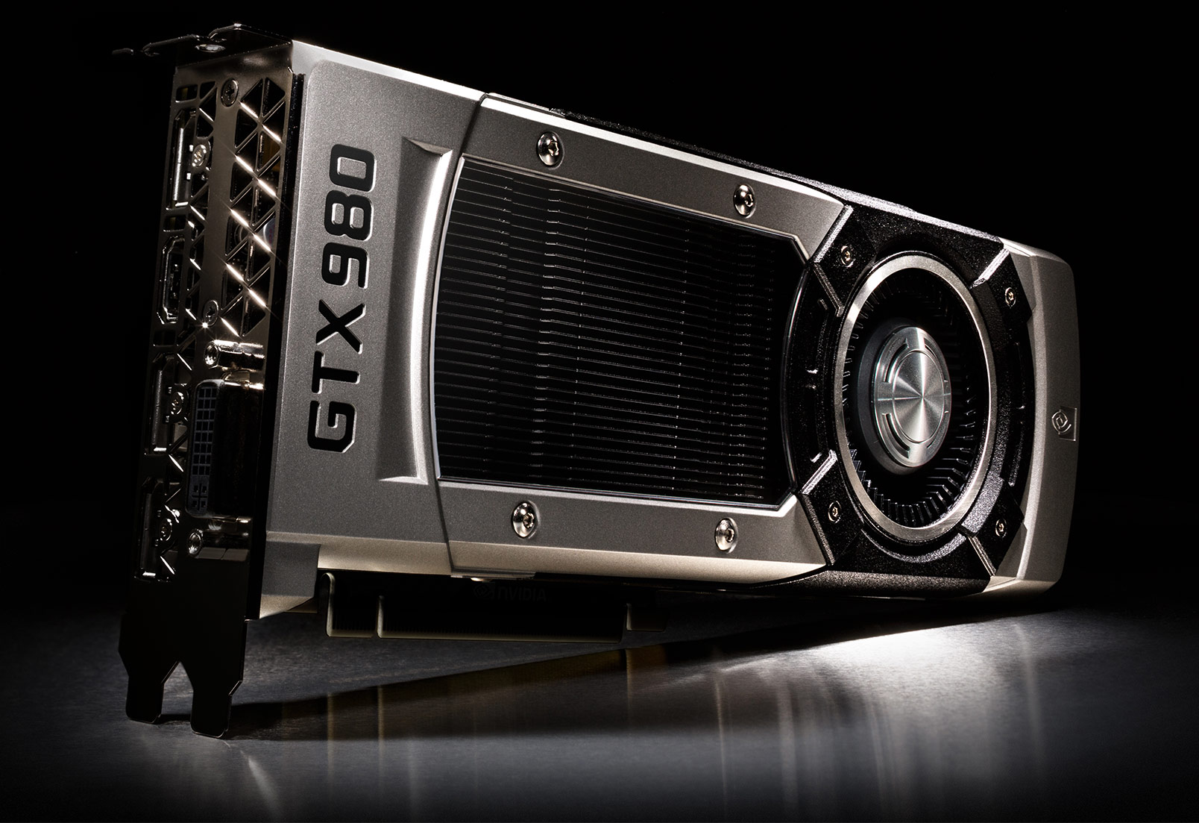
GPU Scaling Trends
GTX 275
(Tesla)
240
CUDA
Cores
(127
GB/sec)
GTX 480
(Fermi)
448
CUDA
Cores
(139
GB/sec)
GTX 680
(Kepler)
1536
CUDA
Cores
(192
GB/sec)
GTX 980
(Maxwell)
2048
CUDA
Cores
(224
GB/sec)
GP 100
(Pascal)
3584
CUDA
Cores
(720
GB/sec)
GV 100
(Volta)
5120
CUDA
Cores
(900
GB/sec)
Notes:
As we know GPU are scaling both in terms of number of CUDA cores as well peak DRAM
Bandwidth. For example, the latest NVIDIA GPU GTX 980 has more than 2000 cores.
Given such powerful GPUs, the question is -- Are we “still” using them efficiently?

Slide 10
Making Good Use of Resources (1)
Deep Learning and Artificial Intelligence
Credit: NVIDIA AI

Slide 11
Making Good Use of Resources (2)
Multiple CPUs send requests to GPUs
Multiple requests from users consolidated in the cloud data center (e.g., NVIDIA GRID)
CPU-1
CPU-2
CPU-3
CPU-N

Slide 12
Memory Bandwidth
One of the major resources in GPUs is memory bandwidth. We need to manage it carefully.
[Performance and Fairness] Current bandwidth optimizations can lead to sub-optimal performance and fairness for multi-application execution.
[Performance and Security] Current bandwidth optimizations (e.g., coalescing) can lead to security vulnerabilities.
Our focus is on developing new bandwidth optimization techniques to improve performance, fairness, and security.

Slide 13
Outline
Memory Bandwidth Management for Performance and Fairness
Efficient and Fair Multi-programming in GPUs via Effective Bandwidth Management, HPCA’18
Focuses on Performance / Fairness Trade-offs
Memory Bandwidth Management for Performance and Security
RCoal: Mitigating GPU Timing Attack via Subwarp-based Randomized Coalescing Techniques, HPCA 2018
Focuses on Performance / Security Trade-offs

Slide 14
Efficient and Fair Multi-programming in GPUs via Effective Bandwidth Management
Haonan Wang, Fan Luo, Mohamed Ibrahim
(College of William & Mary), Onur Kayiran (AMD),
Adwait Jog (College of William & Mary)
Notes:
Hi, my name is Mohamed Assem Ibrahim. Today, I will present our work “Efficient and Fair Multi-programming in GPUs via Effective Bandwidth Management”. This work was jointly performed with my advisor and colleagues at The Collage of William and Mary and our collaborators at AMD.
+++++++++++++++++++++++++++++++++++++
Don’t use
-----------
OK
Right?
Sort of

Slide 15
Executive Summary
Goal: Address the BW interference problem via Thread-level Parallelism (TLP) modulation
Contributions:
Observe that prior single-application TLP modulation schemes do not provide optimal throughput (WS) and fairness (FI) in a multi-application environment
Propose a new metric Effective Bandwidth (EB) to quantify the effects of TLP modulation
Design new application-aware TLP management techniques (PBS) for a better throughput/fairness
PBS improves Throughput (up to 20%) and Fairness (up to 2x) over using single-application TLP modulation schemes in a multi-application environment
Notes:
As a quick overview of our work, we investigate multi-application execution on GPUs. It can increase the resource utilization and overall throughput. Also, it enables sharing GPUs in the cloud. However, it is difficult to efficiently manage the shared BW resources in such environment.
Our goal is to address the BW interference problem using Thread-level Parallelism modulation.
Our contribution is three-fold. First, we studied the prior single-application TLP modulation schemes in a multi-application environment, and found that they don’t provide optimal system throughput and fairness. Second, we propose Effective Bandwidth (EB), a new metric to understand performance in single- and multi-application execution context. Finally, we develop a new application-aware scheme, PBS, that utilizes EB to achieve better throughput and fairness.
PBS improves system throughput up to 20% and achieves up to 2x fairness compared to using single-application TLP modulation schemes in a multi-application environment.
+++++++++++++++++++++++++++++++++++++
Onur: EB is not only for quantifying the effects of TLP modulation. Don't downplay its importance. It is for understanding performance in general, but it is specifically more useful in the context of multi-application execution.
PBS is within 3% and 6% of optWS and optFI
Our proposed pattern-based TLP management mechanisms improve the system throughput and fairness by 20% and 2x, respectively, over a baseline where each application executes with a TLP configuration that provides the best performance when it executes alone.

Slide 16
Managing TLP for Single-Application
Thread-level Parallelism
TLP
Number of Wavefronts/Warps
Change
Cache Hit/Miss Behavior
Cache
DRAM Bandwidth Behavior
DRAM
Notes:
TLP can be used as a knob to manage resources utilization. We start by showing how TLP modulation can be used in a single-application scenario.
As we see in the figure, TLP directly affects the number of wavefronts running, which affects the number of concurrent threads.
As a result, it affects the cache behavior in terms of hit and miss requests.
TLP also affect the DRAM BW behavior.
Now if we increase the TLP value, then we can see a change in both the cache and BW behavior.
+++++++++++++++++++++++++++++++++++++
Onur: The blue arrows in DRAM are not very visible. Maybe red will be better. Or you can make them wider.
Show the DRAM utilization in a better/clear way
Number of Warps = Number of Wavefronts
In particular, the techniques that find the optimal thread-level parallelism (TLP) of a GPGPU application were found to be very effective in improving the GPU performance both for cache and memory-intensive applications [30], [50]. The key idea behind these techniques is to exploit the observation that executing a GPGPU application with the maximum possible TLP does not necessarily result in the highest performance. This is because as the number of concurrently executing threads increases, the contention for cache space and memory bandwidth also increases, which can lead to sub-optimal performance. Therefore, many of the TLP management techniques proposed to limit the TLP via limiting the number of concurrently executing warps (or wavefronts2) to a particular value.

Slide 17
Managing TLP for Single-Application
A single application is executed with
bestTLP | the best-performing TLP configuration
maxTLP | the maximum possible value of TLP
bestTLP
maxTLP
Notes:
For example, this figure shows how changing the TLP can affect the performance of an application. On the x-axis is the different TLP values, and on the y-axis in the normalized IPC.
We first identify two points. “bestTLP” is the TLP configuration with the best IPC, and “maxTLP” is the configuration with the maximum possible TLP value.
We point out two observations. First, using “maxTLP” doesn’t lead to the best IPC. This is because as the number of concurrently executing threads increases, the contention for cache and memory bandwidth also increases, which may lead to sub-optimal performance. Second, as the TLP value increases, the IPC increases till we reach “bestTLP”. After that IPC drops. This is because the increase in BW utilization cannot compensate the increase in cache miss rate.
+++++++++++++++++++++++++++++++++++++
Application = CUDA-BFS2

Slide 18
Challenges of Managing TLP for Multi-Application
Two or more applications are executed concurrently with
++bestTLP | their own respective bestTLP configurations
++maxTLP | their own respective maxTLP configurations
optWS/optFI | their own TLP configurations such that WS/FI is maximized
++bestTLP
++bestTLP
Why?
Notes:
To understand the scope of TLP modulation in the context of two-application execution, we analyzed three different scenarios.
First, both applications executes with their respective “bestTLP” referred to as “++bestTLP”. Second, both applications executes with their respective “maxTLP” referred to as ”++maxTLP”. Finally, both applications executes with TLP configuration such that system throughput or fairness is maximized.
From the figure, we can see that there is a significant gap in WS between optWS and ++bestTLP/++maxTLP combinations running BFS2_FFT workload. The same applies for fairness (FI).
Thus, blindly using the single-application TLP modulation schemes in the context of multi-application execution is sub-optimal. But why?
+++++++++++++++++++++++++++++++++++++
Workload = BFS2_FFT

Slide 19
Why?
L2 Cache
Some applications consume less/more resources compared to co-running application(s)
Difficult management of BW resources in GPUs
Application#1
TLP
Application#2
TLP
How to manage the application interference in the shared caches and main memory to achieve the maximum benefits of multi-application execution?
DRAM
BW Interference Problem
Notes:
This figure shows two co-running applications. Each is given half of the shared resources. We can see that application#1 is consuming its half of the resources as shown in blue, while application#2 is not as shown in green.
This underutilization of resources is because applications have different resources requirement. That is what makes managing the shared BW resources a challenging problem.
Specifically, the BW interference problem is how to manage the applications interference in the shared resources to achieve maximum benefits from multi-application execution.
+++++++++++++++++++++++++++++++++++++
Onur: Why is the negative point about "being unfair"? It might cause people to think about "fairness".
Should we explicitly mention that such configurations consider local information only?

Slide 20
Proposal
Goal
Address the BW interference problem in multi-application execution environment
Contribution
Design new TLP management techniques that can bridge the gap in System Throughput and Fairness
Optimizing performance by considering core-level metrics locally
Application-aware TLP management that make good and judicious use of all the shared resources available
Notes:
In this work, we address the BW interference problem in a multi-application environment.
We develop new TLP management schemes to bridge the gap in system throughput and fairness.
We don’t rely ONLY on local per-core metrics.
But we consider the shared resources as well.
+++++++++++++++++++++++++++++++++++++
TLP technique focusing on BW interference problem.
Although previously proposed TLP modulation techniques (e.g., DynCTA and CCWS) have been shown to be effective in optimizing TLP for single-application execution scenarios, they rely only on different kinds of per-core heuristics (e.g., latency tolerance, IPC, cache/memory contention) and do not consider the shared resource consumption of co-scheduled applications. In other words, each application under such TLP configurations (including bestTLP) attempts to maximize its own effective bandwidth, ultimately taking disproportionate amount of shared resources. This causes too much contention in caches and memory, ultimately hampering the system-wide metrics such as system throughput and fairness.

Slide 21
Effective Bandwidth: A New Metric to Measure Resource Consumption
An application-level utility metric defined as the ratio of attained DRAM bandwidth to the cache miss rate (based on current level of hierarchy)
Core
L1
L2
DRAM
$$EB={BW}/{Cache Miss Rate}$$
C
B
A
$${EB}_{B}={BW}/{{L2}_{Miss Rate}}$$
$${EB}_{C}={BW}/{({L2}_{Miss Rate}×{L1}_{Miss Rate})}$$
$${EB}_{A}=BW$$
Notes:
Effective Bandwidth, EB, is an application-level utility metric, defined as the ratio between the DRAM bandwidth and the cache miss rate based on level of hierarchy under consideration.
For example, in this figure, EB @ point A is the same as the DRAM BW. However, @ point B, EB is the ratio between DRAM BW and L2 miss rate. Finally, @ point C, @ the core, EB is ratio between DRAM BW and the combined miss rate. CMR is the product of L1 and L2 cache miss rates.
+++++++++++++++++++++++++++++++++++++
- Metric concerning BW as BW interference is the main problem.

Slide 22
Effective Bandwidth: A New Metric to Measure Resource Consumption
Measures how well the DRAM bandwidth is utilized
Considers the usefulness of the caches in amplifying the performance
$IPC∝\frac{BW}{{r_{m}×L2}_{Miss Rate}×{L1}_{Miss Rate}}$ $∝\frac{EB}{r_{m}}$
Why EB?
Combined Miss Rate (CMR)
Notes:
But why EB?
EB measures both the DRAM BW utilization and the usefulness of the caches in amplifying the performance. Let us look at EB benefit analytically and experimentally.
Analytically, performance, in terms of IPC, is the ratio between DRAM BW and the product of rm (which is related to the compute to memory ratio) and the combined cache miss rate.
Then, IPC is directly proportional to EB.
This can be shown by monitoring the IPC and the EB. We can see that both IPC and EB follow the same trend when TLP changes. Also, we can see that up to TLP=4 both IPC and EB increases as the increase in BW is more that the increase in CMR. However, after TLP=4, EB drops as the increase in BW is not enough to compensate the increase in CMR. IPC also drops as the contention for cache and memory bandwidth increases.
This shows that EB is a good metric to optimize for performance in a single-application scenario, but what about multi-application?
+++++++++++++++++++++++++++++++++++++
Application = CUDA-BFS2

Slide 23
EB in Multi-Application Environment
$IPC∝\frac{BW}{{r_{m}×L2}_{Miss Rate}×{L1}_{Miss Rate}}$ $∝\frac{EB}{r_{m}}$
$${IPC}_{AR}={{IPC}_{Alone−1}}/{{IPC}_{Alone−2}}$$
$${EB}_{AR}={{EB}_{Alone−1}}/{{EB}_{Alone−2}}$$
$$WS=\frac{{IPC}_{Shared−1}}{{IPC}_{Alone−1}}+\frac{{IPC}_{Shared−2}}{{IPC}_{Alone−2}}$$
$$WS∝{IPC}_{Shared−1}+{IPC}_{Shared−2}×{IPC}_{AR}$$
$$EB∝{EB}_{Shared−1}+{EB}_{Shared−2}×{EB}_{AR}$$
Example: For BLK and BFS2 workload, IPC ratio is 25 but EB ratio is 2

Slide 24
EB in Multi-Application Environment
A TLP management scheme that optimizes for EB-based metrics is useful in improving system throughput and fairness
SD-based Metrics
EB-based Metrics
Slowdown | SD | $${{IPC}_{Shared}}/{{IPC}_{bestTLP}}$$
Weighted Speedup | WS | $${SD}_{1}+{SD}_{2}$$
Fairness Index | FI | $$Min({{SD}_{1}}/{{SD}_{2}},{{SD}_{2}}/{{SD}_{1}})$$
Effective Bandwidth | EB | $${BW}/{CMR}$$
Weighted Speedup | $${EB}_{WS}$$ | $${EB}_{1}+{EB}_{2}$$
Fairness Index | $${EB}_{FI}$$ | $$Min({{EB}_{1}}/{{EB}_{2}},{{EB}_{2}}/{{EB}_{1}})$$
Easier to calculate in shared environment
Details in paper
Challenge?
Notes:
However, a management scheme that optimizes for EB-based metrics is useful in improving system throughput and fairness.
Thus, we introduce our version of the SD-based metrics for system throughput and fairness and utilize EB instead of slowdowns. For example, EB-WS is the sum of EBs instead of using the sum of slowdowns. Another, crucial factor here is that EB-based metrics don’t incorporate any alone-execution information. This makes EB-based metrics easier to calculate in a multi-application environment.
But what is the challenge in using EB?
+++++++++++++++++++++++++++++++++++++
Mention the alone information in SD-based metrics vs. EB-based metrics.
EB-WS (EB-based) metric does not incorporate any alone-application information making it easier to calculate directly in a multi-application environment.
Note: In the latter case, each application uses the value of EB when it executes alone and uses bestTLP. As we cannot get this information unless we halt the other co-running applications, we approximate it by executing the co-runners with the least amount of TLP (i.e., 1) so that they induce the least amount of interference possible.

Slide 25
Challenge? Search Space
Finding the TLP combination is difficult
Huge search space
Assume $n$ applications with $TLP= \left\{1, 2, 4, 8, 12, 16, 20, 24\right\}$
$Search Space=8^{n}$
Sampling period to collect $BW$ and $CMR$
Solution?
Notes:
Finding the optimal TLP configuration is difficult. This is due to the huge search space. For example, using n co-running applications, while selecting from 8 TLP values per application, leads to 8^n search space.
Add the sampling period required, per configuration, to collect BW and CMR, this shows how bad a naïve searching technique can fail.
So, what is the solution?
+++++++++++++++++++++++++++++++++++++
We need an intelligent way to find the required TLP

Slide 26
Pattern-Based Searching (PBS)
Guideline-1
To reach optimal system throughput
Choose a TLP configuration that does not underutilize the shared resources
Guideline-2
To avoid sharp drops in one (or all) applications’ EB, hence inferior throughput and fairness
Choose a TLP configuration which would not overwhelm the DRAM BW
Pattern?
Notes:
We start by emphasizing two guidelines. First, EB-based metrics are sub-optimal if a TLP configuration leads to resources underutilization. Thus, to reach optimal system throughput, choose a TLP configuration that does not underutilize the shared resources.
Similarly, we should choose a TLP configuration that does not overwhelm the shared resources. This is because EB-based metrics start to drop when the increase in BW can no longer compensate the increase in CMR.
Now, we define the pattern used in the searching scheme.
+++++++++++++++++++++++++++++++++++++
Total EB can be sub-optimal when a particular TLP configuration leads to under-utilization of resources (DRAM and BW)
Guideline-1. The EB-based metrics are sub-optimal when a particular TLP combination leads to under-utilization of resources (e.g., DRAM bandwidth). Therefore, for obtaining the optimal system throughput, it is important to choose a TLP combination that does not under-utilize the shared resources.
EB of an application starts to drop only when its BW can no longer compensate for the increase in its CMR
Guideline-2. When increasing an application’s TLP level, its EB starts to drop only when the increase in its BW can no longer compensate for the increase in its CMR (i.e., EB at its inflection point). Therefore, it is important to choose a TLP combination that would not overwhelm resources as it is likely to cause sharp drops in one or all applications’ EB, leading to inferior system throughput and fairness.

Slide 27
Pattern-Based Searching (PBS)
Pattern
Significant drop in EB-based metric happens at a fixed TLP of a particular application, when the resources in the system are sufficiently utilized, regardless of TLP of other co-running application(s)
Notes:
The figure show the execution of BLK_TRD workload, with EB-WS on the y-axis. We vary the TLP values of BLK on the x-axis, and show the different TLP values of TRD as colored/dashed lines.
The pattern:
- is a significant drop in the EB-based metric
- that happens at a fixed TLP of a particular application
- when the resources are sufficiently utilized
- regardless of the TLP of the other co-running application
For example, we see that EB-WS drops @ TLP-BLK = 2 regardless the TLP value of TRD. We refer to this as the pattern for BLK.
+++++++++++++++++++++++++++++++++++++
at the DRAM BW saturation point? How to show that?
Significant drop in EB happens at a fixed TLP of a particular application at the DRAM BW saturation point (regardless of TLP of other co-running applications)

Slide 28
PBS – High-level Searching Process
1- Find the Critical Application
Sequentially check each application for the pattern while maintaining full resource utilization
2- Tune the Co-running Application(s)
Tune the co-running application TLP to optimize the EB-based metric
The sharpest drop in EB-based metrics is attributed to the critical application
Reducing the search space from $8^{n}$ (Exponential) to $8n$ (Linear)
Notes:
Now, we give a high-level overview for our searching scheme.
First, we search for what we refer to as the critical application. We do that by sequentially checking each of the co-running applications for the pattern.
The application with the sharpest drop in the EB-based metric is the critical application.
Second, we fix the TLP of the critical application @ its inflection point and sequentially tune the co-running application(s) to optimize the EB-based metric.
This process reduces the exponential search space to a linear one.
+++++++++++++++++++++++++++++++++++++

Slide 29
Evaluation Methodology
Evaluated on MAFIA
A GPGPU-Sim based framework that can execute two or more applications concurrently
Baseline Configuration
30 SMs, 32-SIMT Lanes, 32 Threads/Wavefront, 48 Wavefronts
16KB L1 (4-way, 128B Cache Block) + 32KB Shared Memory per SM
256KB L2 (16-way, 128B Cache Block) per Memory Partition
6 Memory Partitions
1 Crossbar/Direction
Workloads
26 Single Applications
From Rodinia, Parboil, CUDA SDK, and SHOC
50 Two-application Workloads
20 Three-application Workloads
Notes:
We evaluate PBS on MAFIA, a GPGPU-Sim based framework that executes two (or more) applications concurrently.
We use 30 cores equally divided between the co-running applications. For example, in case of two-application scenario, each application is statically assigned 15 cores. However, the L2 cache and DRAM BW are shared.
We use 26 applications from different benchmarks suites to evaluate 50 two-application workloads, and 20 three-application workloads.
+++++++++++++++++++++++++++++++++++++
Extended GPGPU-Sim v3.x (Simulator) and developed GPU concurrent application framework (GCA) to enable multi-programming in GPUs.
The memory performance model is validated across several GPGPU workloads on an NVIDIA K20m GPU.
To understand how these applications interfere in the shared memory system, each application is mapped to an exclusive set of cores and allowed to use resources beyond the cores (e.g., L2, DRAM). We allocate an equal number of cores to each concurrently executing application. Sensitivity to different core and L2 cache partitioning techniques is discussed later.

Slide 30
Evaluation – Throughput
[Kayiran+, PACT2013]
[Li+, DATE2016]
++bestTLP
++DynCTA
Mod+Bypass
optWS
+19.6%
+11.2%
+9.7%
-3%
Notes:
We start with system throughput. This figure shows the normalized WS on the y-axis normalized to ++bestTLP.
Our scheme, PBS-WS, achieves 19.6% improvement over ++bestTLP.
Also, PBS-WS achieves 11.2% improvement over a scheme that uses DynCTA, which is a single-application TLP modulation scheme, to determine the TLP for each co-running application.
PBS-WS achieves 9.7% improvement over a recently proposed TLP management mechanism Mod+Bypass, that use CTA modulation and cache bypassing to enhance the system throughput in multi-application scenario.
Finally, our scheme is within 3% from the optimal WS.
+++++++++++++++++++++++++++++++++++++
This is because in “++bestTLP” or “++maxTLP” scenarios, each application assumes that no other application is co-scheduled. That leads to high cache and memory contention.
Explain FWT_TRD?
Impact of our schemes on Weighted Speedup. Results are normalized to ++bestTLP.
We compare the PBS mechanisms against the recently proposed TLP management mechanism Mod+Bypass for multi-application scenario. They use both CTA modulation and cache bypassing mechanism to enhance the system throughput.

Slide 31
Evaluation – Fairness
[Kayiran+, PACT2013]
[Li+, DATE2016]
++bestTLP
++DynCTA
Mod+Bypass
optFI
2X
+83.1%
+44.3%
-6%
Notes:
We move to fairness. This figure shows the normalized fairness index (FI) on the y-axis normalized to ++bestTLP.
Our scheme, PBS-FI, improves fairness by 2x compared to ++bestTLP.
Also, PBS-FI achieves 83.1% improvement over a scheme that uses DynCTA.
PBS-FI achieves 44.3% improvement over using Mod+Bypass.
Finally, our scheme is within 6% from the optimal FI.
+++++++++++++++++++++++++++++++++++++
PBS-FI is better than optFI?
Impact of our schemes on Fairness. Results are normalized to ++bestTLP.

Slide 32
Conclusion
Observe an ample scope for TLP management techniques to improve WS and FI in GPUs running multiple applications
Propose a new metric EB to quantify the effects of TLP modulation
Design PBS, EB-based application-aware TLP management techniques for a better WS/FI in a multi-application environment
PBS is within 3% and 6% of optWS and optFI
Notes:
To conclude, we observed a large scope a TLP management scheme to improve system throughput and fairness in a multi-application environment.
We proposed a new metric called Effective Bandwidth to model the performance in a single- and multi-application scenarios.
Also, we designed PBS, EB-based application aware TLP management schemes to enhance WS and fairness. Our results are within 3% and 6% of optimal WS and fairness.
+++++++++++++++++++++++++++++++++++++
Should I add “PBS improves WS (up to 20%) and FI (up to 2x)”?

Slide 33
Outline
Memory Bandwidth Management for Performance and Fairness
Efficient and Fair Multi-programming in GPUs via Effective Bandwidth Management, HPCA’18
Focuses on Performance / Fairness Trade-offs
Memory Bandwidth Management for Performance and Security
RCoal: Mitigating GPU Timing Attack via Subwarp-based Randomized Coalescing Techniques, HPCA 2018
Focuses on Performance / Security Trade-offs

Slide 34
RCoal: Mitigating GPU Timing Attack via Subwarp-based Randomized Coalescing Techniques
Gurunath Kadam (College of William & Mary)
Danfeng Zhang (Penn State University)
Adwait Jog (College of William & Mary)

Slide 35
Security Concerns
GPUs may be accelerating applications that are using user-sensitive data (e.g., genomics, financial)
GPUs may be accelerating cryptographic applications (e.g., AES, RSA etc.) and authentication algorithms on-behalf of CPUs
Given the popularity of GPUs, It is imperative to keep GPUs secure against a variety of side-channel attacks and other security vulnerabilities.

Slide 36
Security Attacks
User’s web activity on GPU can be tracked by the malicious attacker who is co-located on the same card [Oakland 2014]
AES private keys can be recovered by correlation timing attacks [HPCA 2016]
More severe attacks on GPUs? [Oakland’18]
Spectre/Meltdown like attacks for GPUs?

Slide 37
Correlation Timing Attacks
Server
Plaintexts | Ciphertexts | Time duration
Plaintext # 1
Ciphertext # 1
time₁
Plaintext # 2
Ciphertext # 2
time₂
Plaintext # 3
Ciphertext # 3
time₃
…
…
…
Correct Key??
Correct Key
K₁ , K₂ , … ,
, …
K_{i}
Attacker
time_{start}
- time_{stop} = time₁
Key guesses
Notes:
This should be a general timing attack description

Slide 38
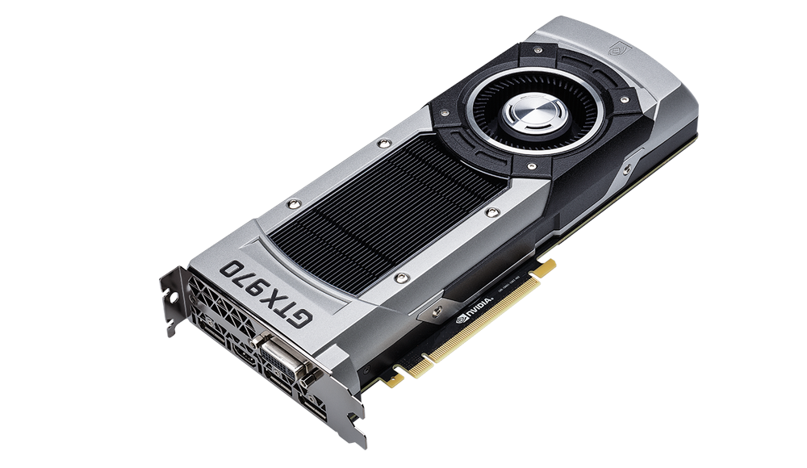
Correlation Timing Attacks
GPU
GPUs implement SIMD paradigm
Fast and energy efficient computations
Accelerate the cryptographic algorithms
Are GPUs vulnerable to Correlation Timing Attacks?
Notes:
Highlight the GPU – Make bigger put block
Highlight the importance of GPU in words

Slide 39
Summary of our HPCA’18 work
Prior Work: Correlation Timing Attacks on GPUs ([Jiang/Fei/Kaeli, HPCA’16])
Coalesced memory accesses and execution time are correlated.
AES key value affects the coalesced accesses.
Coalescing procedure is deterministic and known to the attacker.
Attacker can recover AES key by calculating coalesced accesses and correlating it with the execution time.
Our Contribution: Randomizing the Coalescing Mechanism (RCoal)
Goal: Make the calculation of coalesced accesses harder for the attacker.
Our proposal: Three novel coalescing mechanisms that randomize the size, number, and thread-elements of a sub-warp.
Results: RCoal improves security by 24- to 961- times at a modest performance loss of 5 to 28%.
Notes:
In to two slides – show successful and unsuccessful correlation plots
Last round memory accesses can be determined using AES key.
Memory accesses are coalesced together deterministically by GPUs and hence can be calculated correctly by an attacker.
Number of coalesced memory accesses correlates with the execution time.

Slide 40
Memory Access Coalescing in GPUs
Streaming Multiprocessor
Warp pool
Warp
Thread # 1
. . .
Thread # 32
Warp Scheduler
LD/ST Unit
Coalescing Unit
Global Memory

Slide 41
Memory Access Coalescing in GPUs
WARP
tid = thread id
tid = 0
tid = 1
tid = 2
tid = 3
0x00
0x04
0x07
0x09
Block Address # 0
0x00
0x01
0x02
0x03
Block Address # 1
0x04
0x05
0x06
0x07
Block Address # 1
0x04
0x05
0x06
0x07
Block Address # 2
0x08
0x09
0x0A
0x0B

Slide 42
Memory Access Coalescing in GPUs
WARP
tid = thread id
tid = 0
tid = 1
tid = 2
tid = 3
0x00
0x04
0x07
0x09
Coalescing Unit
Block Address # 0
0x00
0x01
0x02
0x03
Block Address # 1
0x04
0x05
0x06
0x07
Block Address # 2
0x08
0x09
0x0A
0x0B

Slide 43
AES implementation on GPU
Symmetric Encryption with 128-bit key and 10 rounds.
S-box implementation involves table lookups.
[Jiang/Fei/Kaeli, HPCA’16] demonstrated that the last round is vulnerable.

Slide 44
Last Round of AES on GPU
$c_{j}^{tid}= T_{4}[t_{i}^{tid}] ⊕ k_{j}$

Slide 45
Last Round of AES on GPU
$c_{j}^{tid}= T_{4}[t_{i}^{tid}] ⊕ k_{j}$
t_{i}¹
Thread # 1
T₄[t_{i}¹]
Request # 1
Replies # 1
⊕ k_{j}
c_{j}¹
LINE # 1
LINE # 2
Thread # 2
T₄[t_{i}²]
Request # 2
Replies # 2
⊕ k_{j}
t_{i}²
c_{j}²
.
.
.
.
.
.
.
.
.
.
.
.
.
.
.
.
.
.
.
.
.
.
.
.
…
…
Coalescing
Unit
…
…
t_{i}³²
Thread # 32
T₄[t_{i}³²]
Request # 32
Replies # 32
⊕ k_{j}
LINE # 32
c_{j}³²
Input text
to Last Round
Ciphertext

Slide 46
Correlation Timing Attack on GPU
Goal of the attack: Recover the AES Key (byte-by-byte)
Last Round of AES is vulnerable
Last Round is invertible
$$c_{j}^{tid}= T_{4}[t_{i}^{tid}] ⊕ k_{j}$$
Memory access
of thread tid
$t_{i}^{tid}= T_{4}^{−1}[c_{j}^{tid} ⊕k_{j}]$
How an attacker can calculate the number of coalesced accesses?
Notes:
After the goal, Attack model – using figure slide 2. What is available to the attacker – ciphertext, execution time and AES Tables.

Slide 47
Attacker calculates the # of coalesced accesses
$t_{i}^{tid}= T_{4}^{−1}[c_{j}^{tid} ⊕k_{j}]$
Guessed Table
Lookup Indices
c_{j}¹
⊕ k_{j}^{m}
T₄⁻¹[c_{j}¹⊕k_{j}^{m}]
t_{i}^{1,m}
c_{j}²
⊕ k_{j}^{m}
T₄⁻¹[c_{j}²⊕k_{j}^{m}]
t_{i}^{2,m}
Correct value of key byte?
.
.
.
.
.
.
.
.
.
.
.
.
.
.
.
.
.
.
.
.
.
…
…
Coalesced Accesses
(A_{j}^{m,n})
c_{j}³²
⊕ k_{j}^{m}
T₄⁻¹[c_{j}³²⊕k_{j}^{m}]
t_{i}^{32,m}
Ciphertext

Slide 48
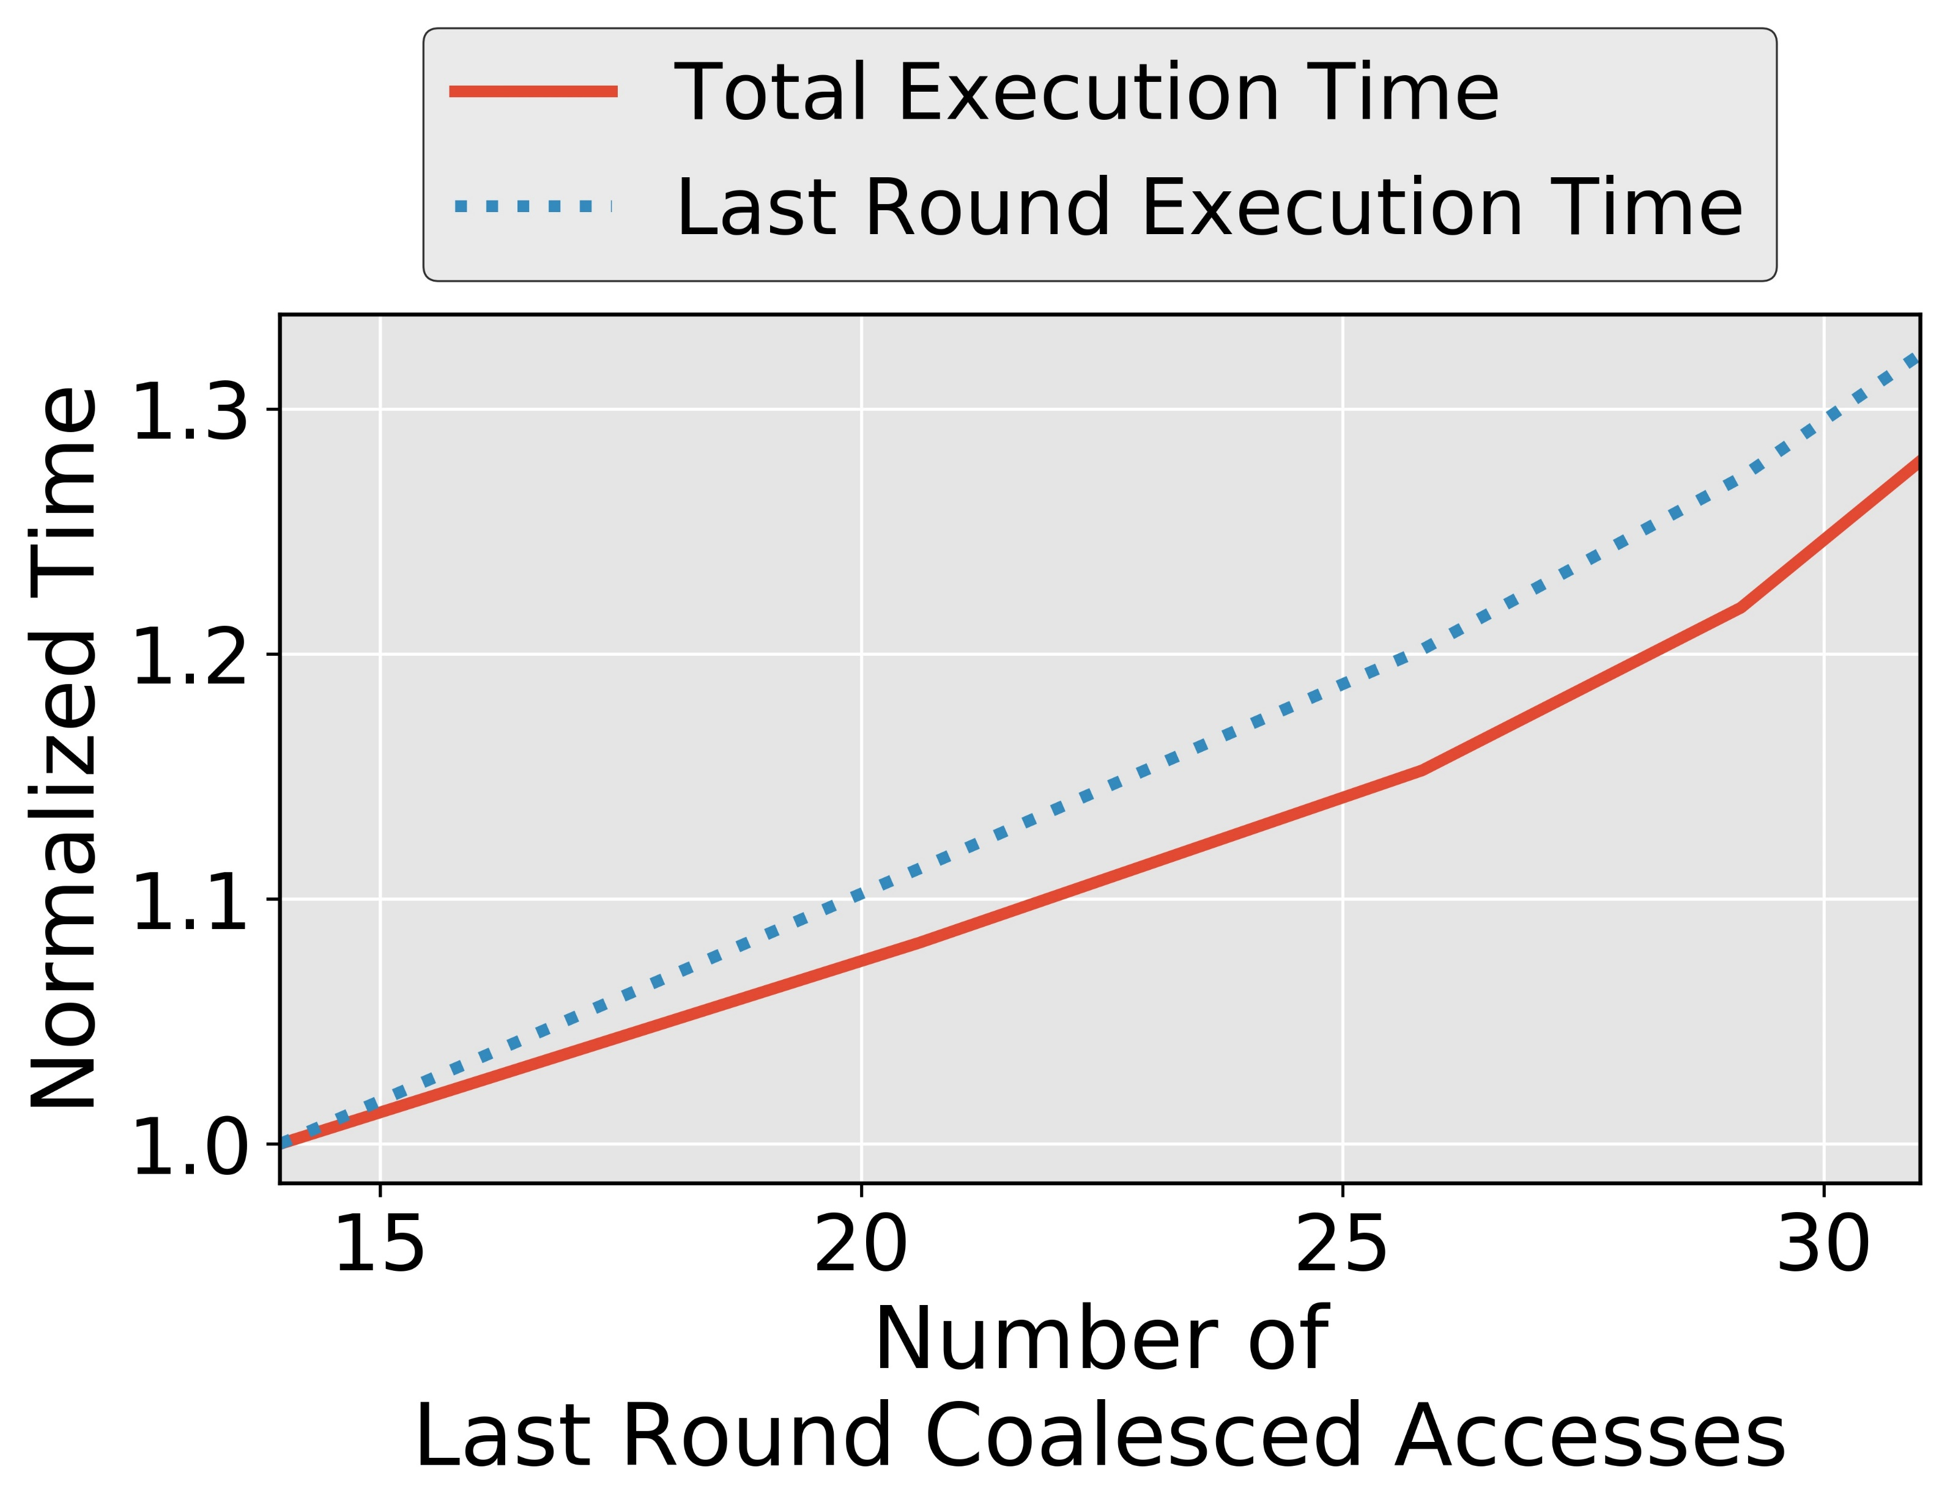
Coalesced Accesses and Execution Time
Associate the number of coalesced accesses with execution time
Notes:
Say on our set-up

Slide 49
Finding the Correct Key Value
Attacker encrypts ‘N’ number of plaintexts over server
Records Ciphertext and Execution time
Recorded
Execution Time
# of Coalesced Accesses
Correlations
Key Guess 0
A_{j}^{0,1}, A_{j}^{0,2}, . . . . , A_{j}^{0,N}
E₁,E₂,...,E_{N}
Corr_{j}⁰
Key Guess 1
A_{j}^{1,1}, A_{j}^{1,2}, . . . . , A_{j}^{1,N}
Corr_{j}¹
.
.
.
.
.
.
Correct
Key Byte
Maximum Correlation
Key
Guess α
A_{j}^{α,1}, A_{j}^{α,2}, . . . . , A_{j}^{α,N}
Corr_{j}^{α}
.
.
.
.
.
.
Key
Guess 255
A_{j}^{255,1}, A_{j}^{255,2}, . . . . ,A_{j}^{255,N}
Corr_{j}²⁵⁵
Notes:
Eliminate the slide transition

Slide 50
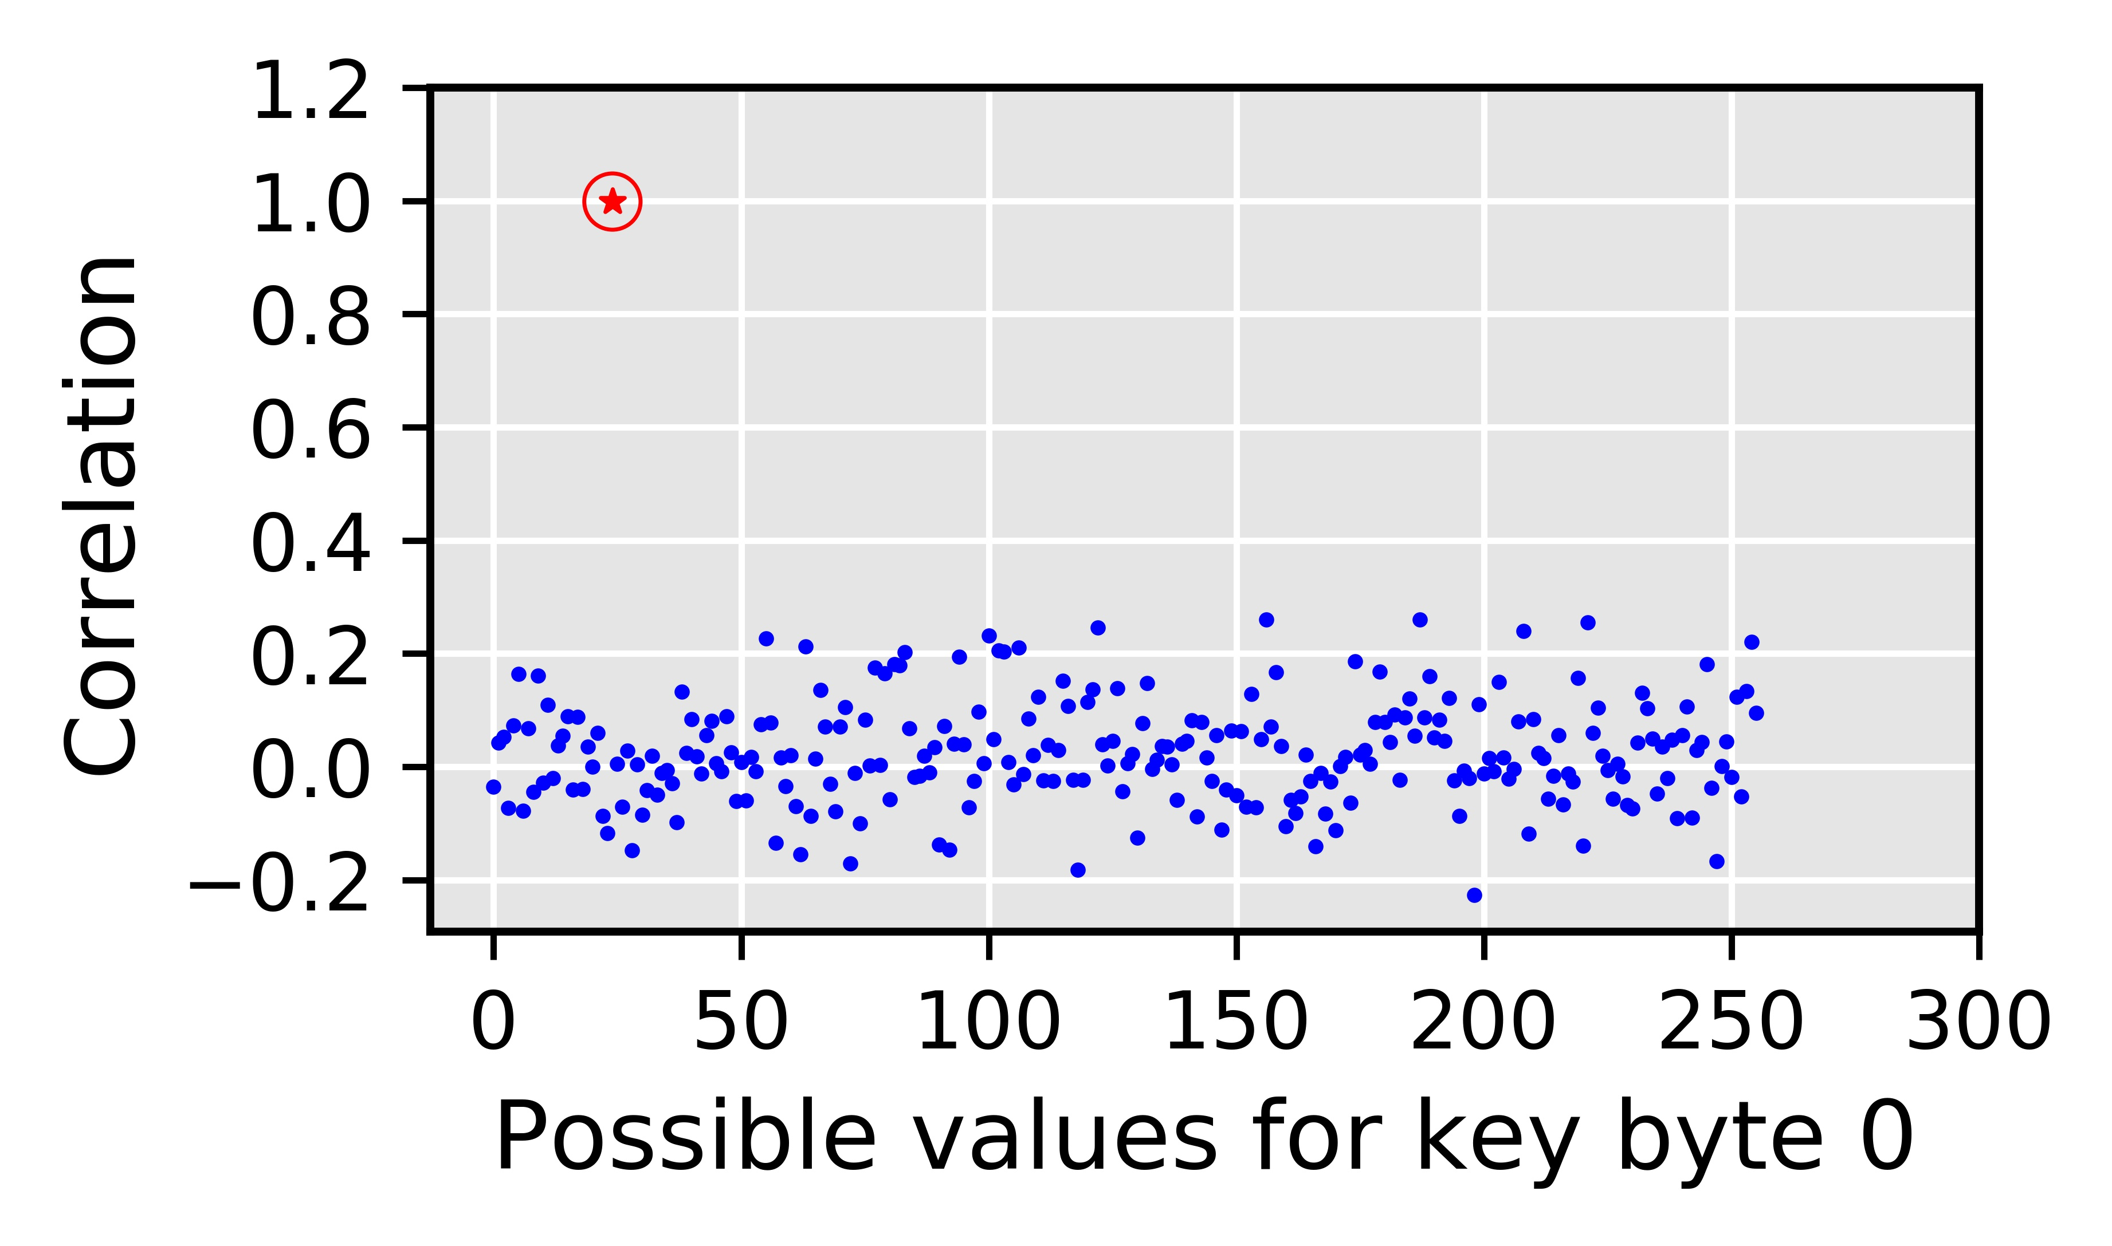
Simulating Timing Attack on our Set-up
Why is Correlation Timing Attack possible?
The baseline attack leverages the deterministic nature of the coalescing mechanism
AES key value affects the coalesced accesses
# coalesced accesses affects the execution time
How to mitigate Correlation Timing Attacks on GPU?
Answer: By making it harder for the attacker to correctly calculate the number of coalesced accesses
Correct guess
Incorrect guesses
Notes:
TODO: Coalescing good for performance and bad for security

Slide 51
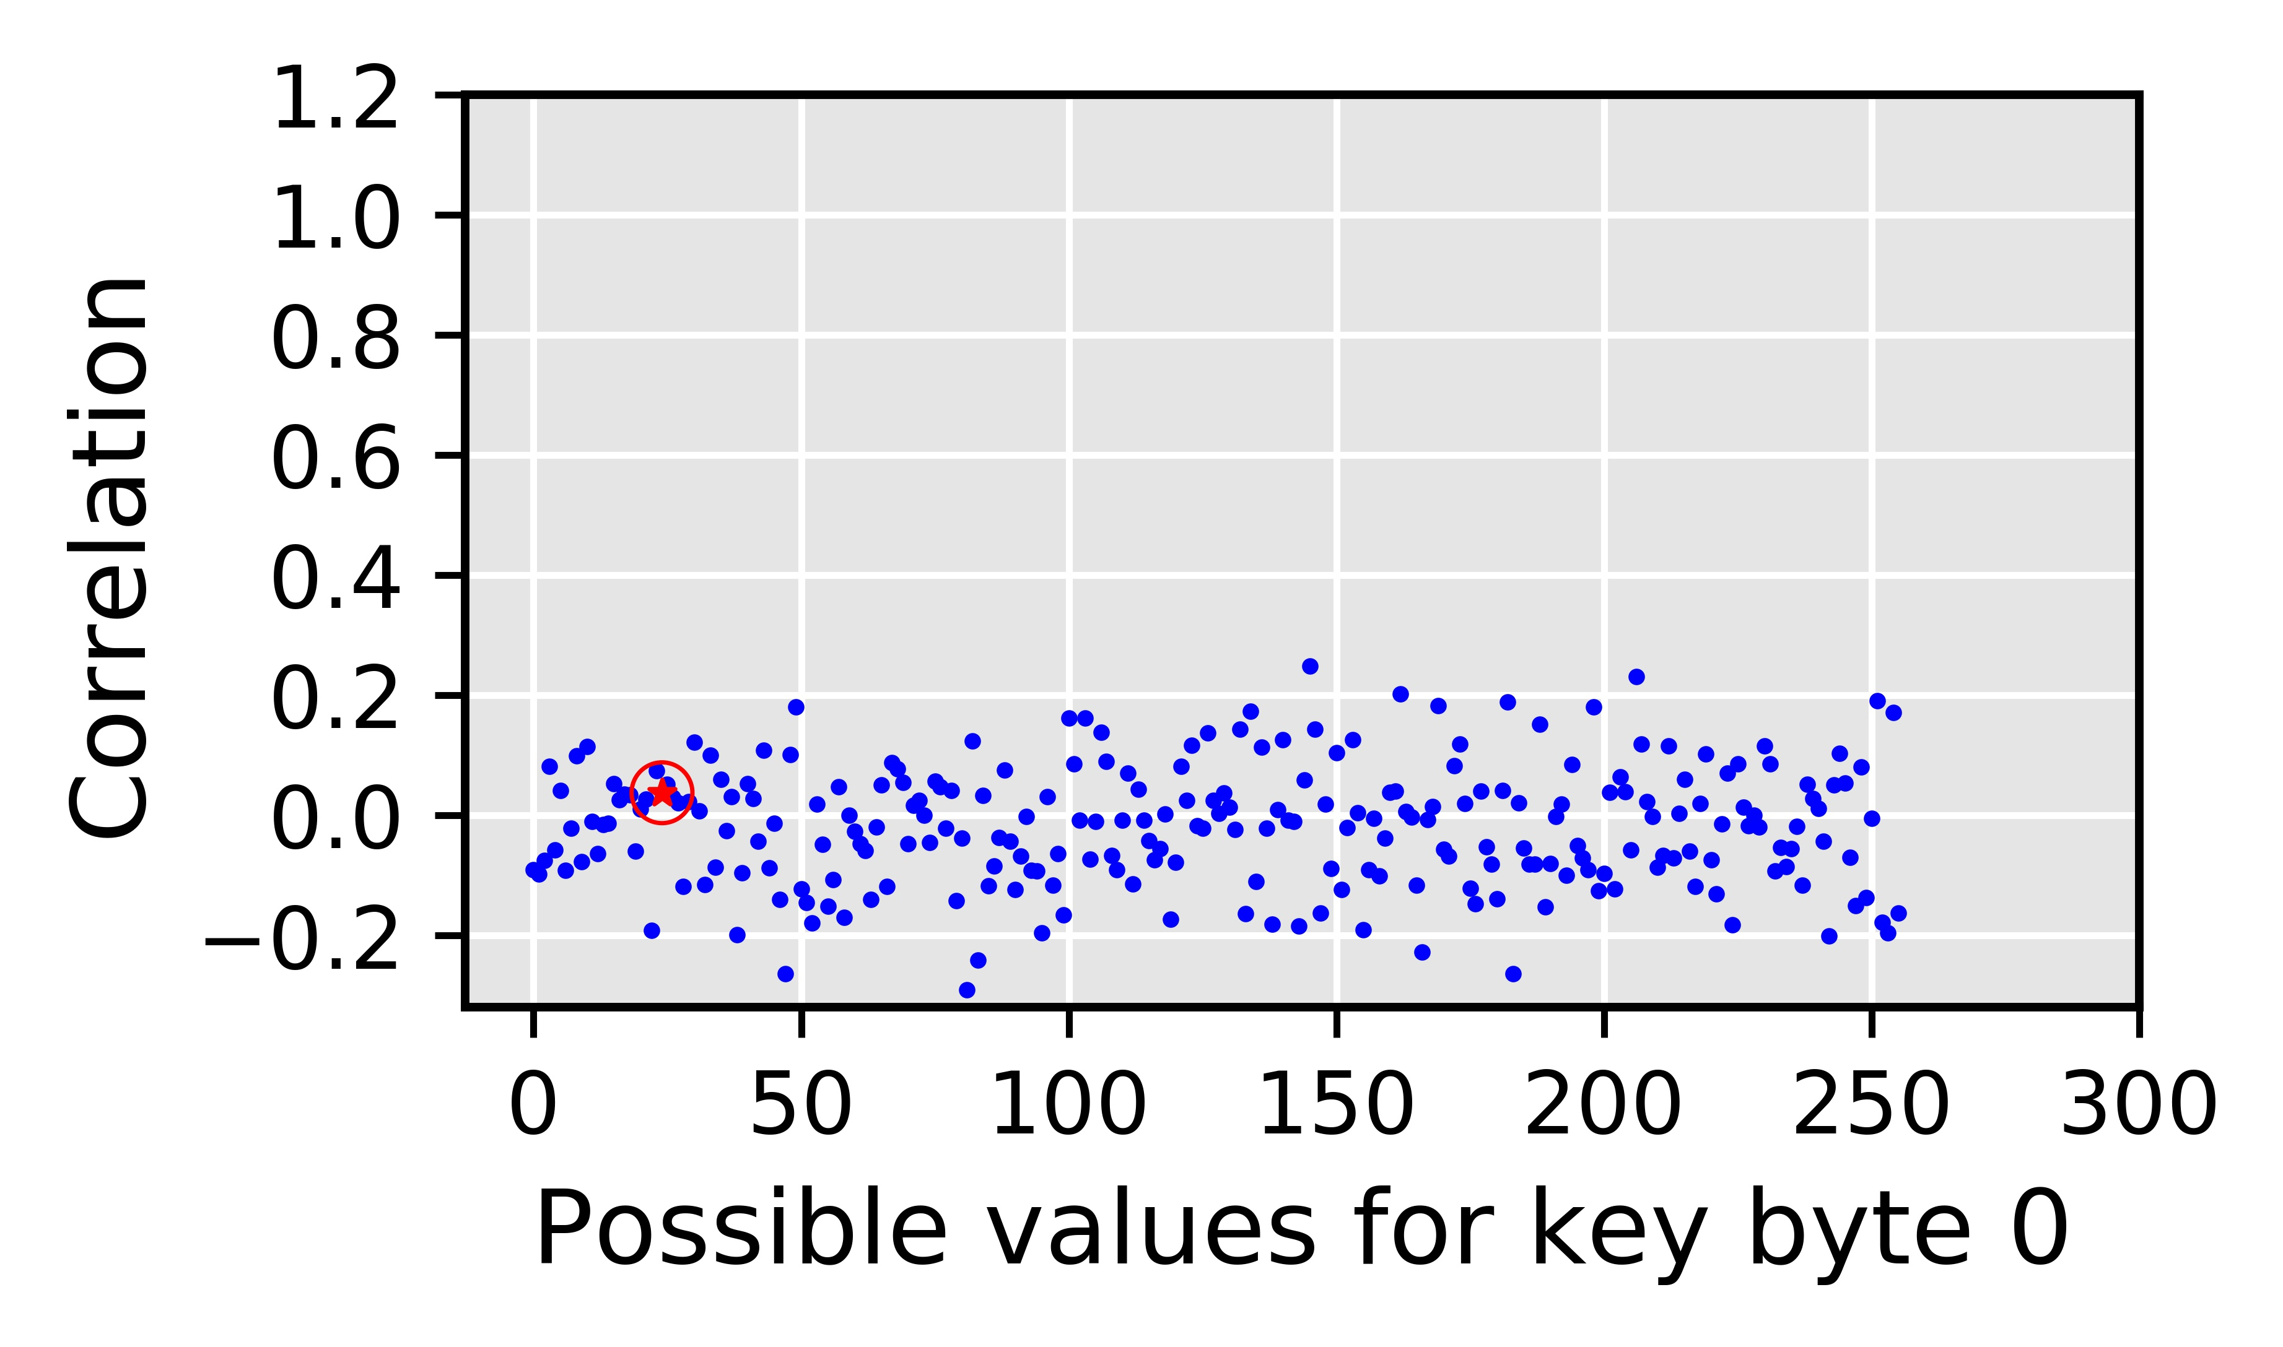
Naïve Solution
Targets the deterministic nature of the coalescing mechanism
Fixed number of subwarps
Fixed sizes of subwarp
Deterministic mapping of the thread elements to subwarps
Disable coalescing altogether?
Correlation drops to ~0
Correct key byte is indistinguishable
Up to 178% performance degradation
Degradation increases with plaintext size
RCoal to mitigate the correlation timing
attacks
Correct guess
Naïve solution is Good for Security, Bad for Performance
Offers no tradeoff

Slide 52
RCoal: Fixed Sized Subwarp (FSS)
DEFAULT: number of subwarps = 1
FSS: number of subwarps = 2
sid = 0
sid = 0
sid = 1
tid = 0
tid = 1
tid = 2
tid = 3
tid = 0
tid = 1
tid = 2
tid = 3
0x00
0x04
0x07
0x09
0x00
0x04
0x07
0x09
Coalescing Unit
Coalescing Unit
0x00
0x01
0x02
0x03
0x00
0x01
0x02
0x03
0x04
0x05
0x06
0x07
0x04
0x05
0x06
0x07
0x04
0x05
0x06
0x07
0x08
0x09
0x0A
0x0B
0x08
0x09
0x0A
0x0B
Notes:
Fixed Size Subwarp eliminates the fixed number of subwarps based determinism.

Slide 53
FSS Security against Baseline Attack
Correlation between the number of coalesced accesses and the execution time drops
Correct key byte is harder to find
Improved security

Slide 54
FSS Performance
Memory accesses increase with number of subwarps
Execution time increases with number of subwarps
Performance degrades as number of subwarp increase
Can attacker still recover the AES key?
Notes:
Better transition going into FSS attack

Slide 55
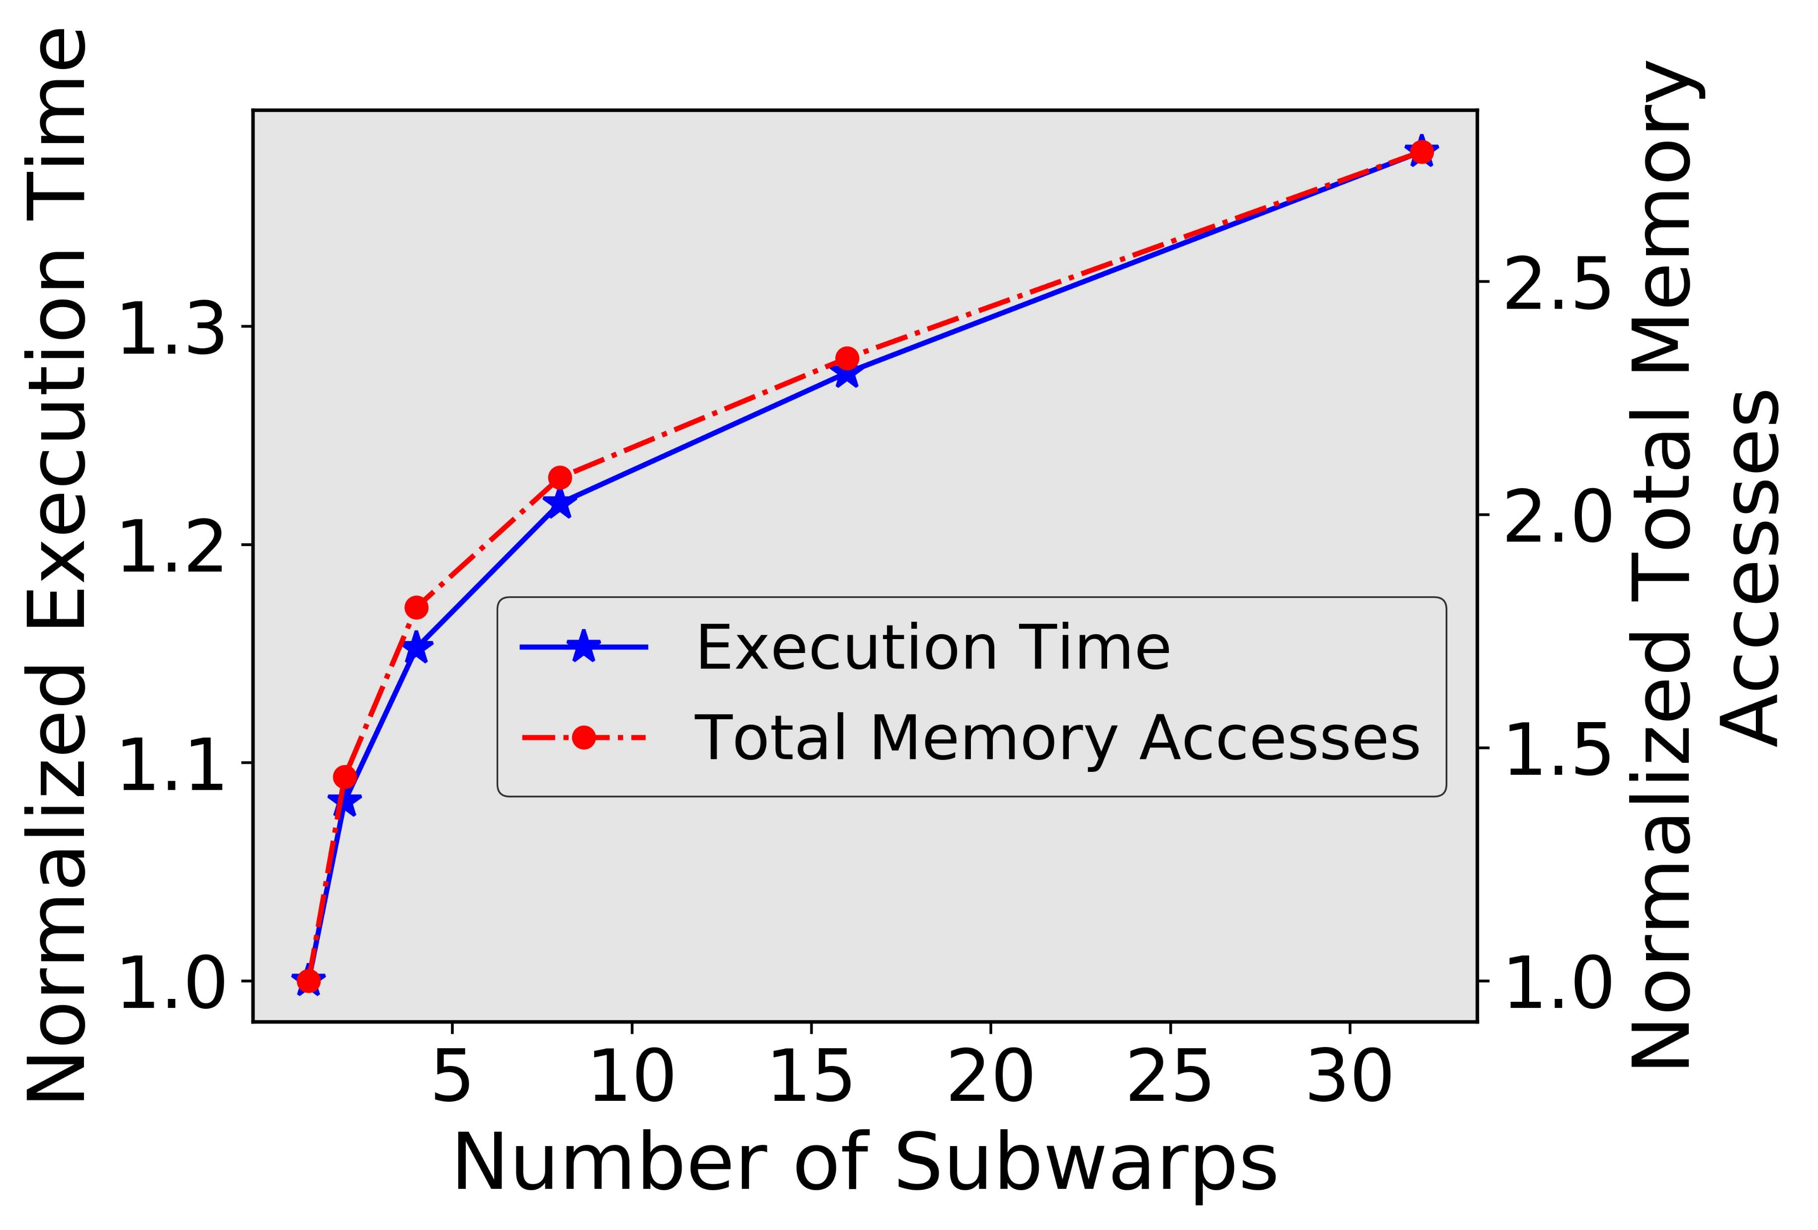
FSS against FSS attack
Attacker can figure out the number of subwarps
Notes:
Why FSS attack?

Slide 56
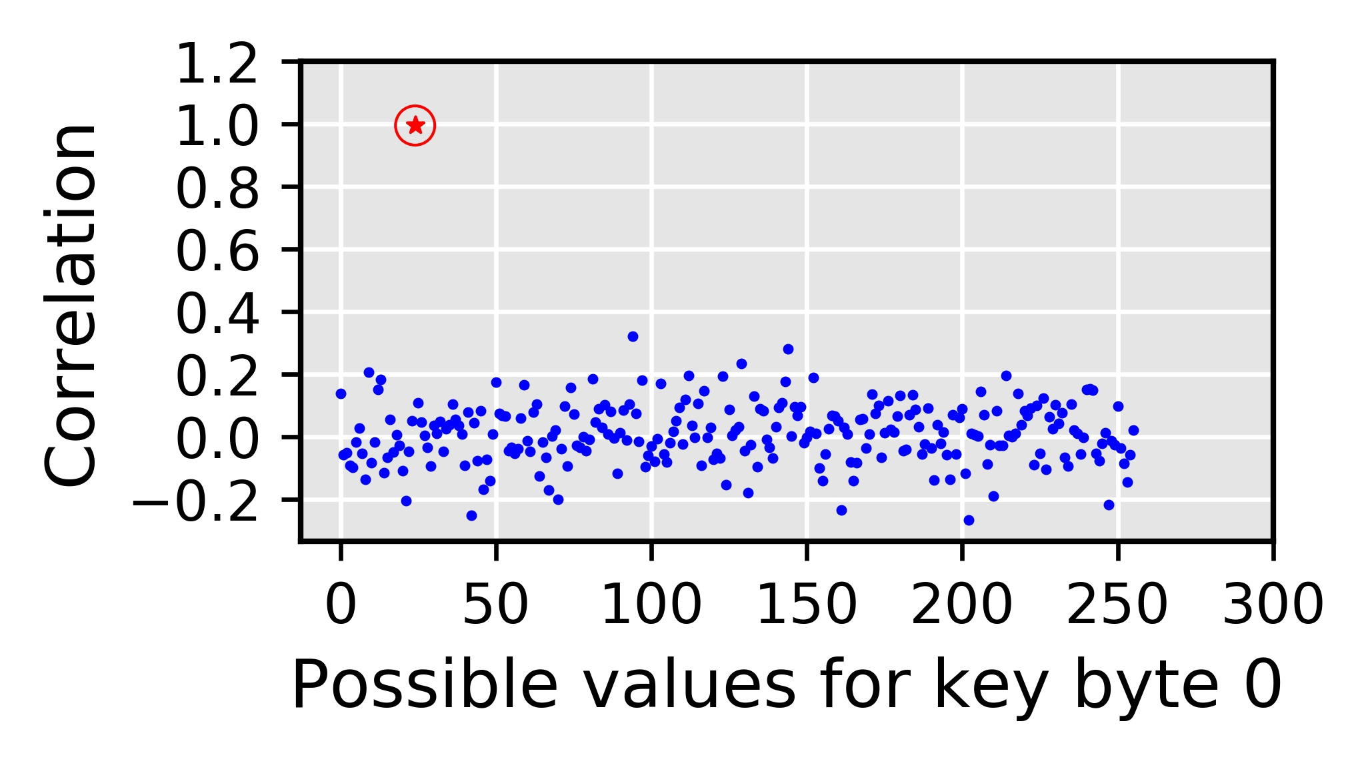
FSS against FSS attack
Attacker can figure out the number of subwarps
Attacker can calculate per subwarp accesses
Correct guess

Slide 57
FSS against FSS attack
Targets the deterministic nature of the coalescing mechanism
Fixed number of subwarps
Fixed sizes of subwarp
Deterministic mapping of the thread elements to subwarps
Attack possible when the attacker can figure out number of subwarps!
Coalescing still deterministic
RCoal to mitigate the correlation timing
attacks

Slide 58
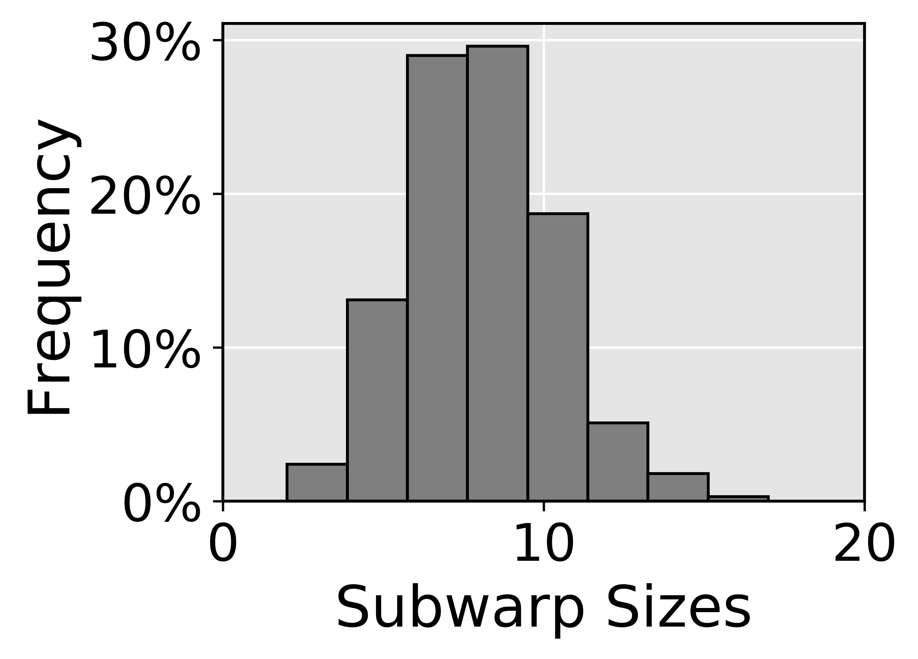
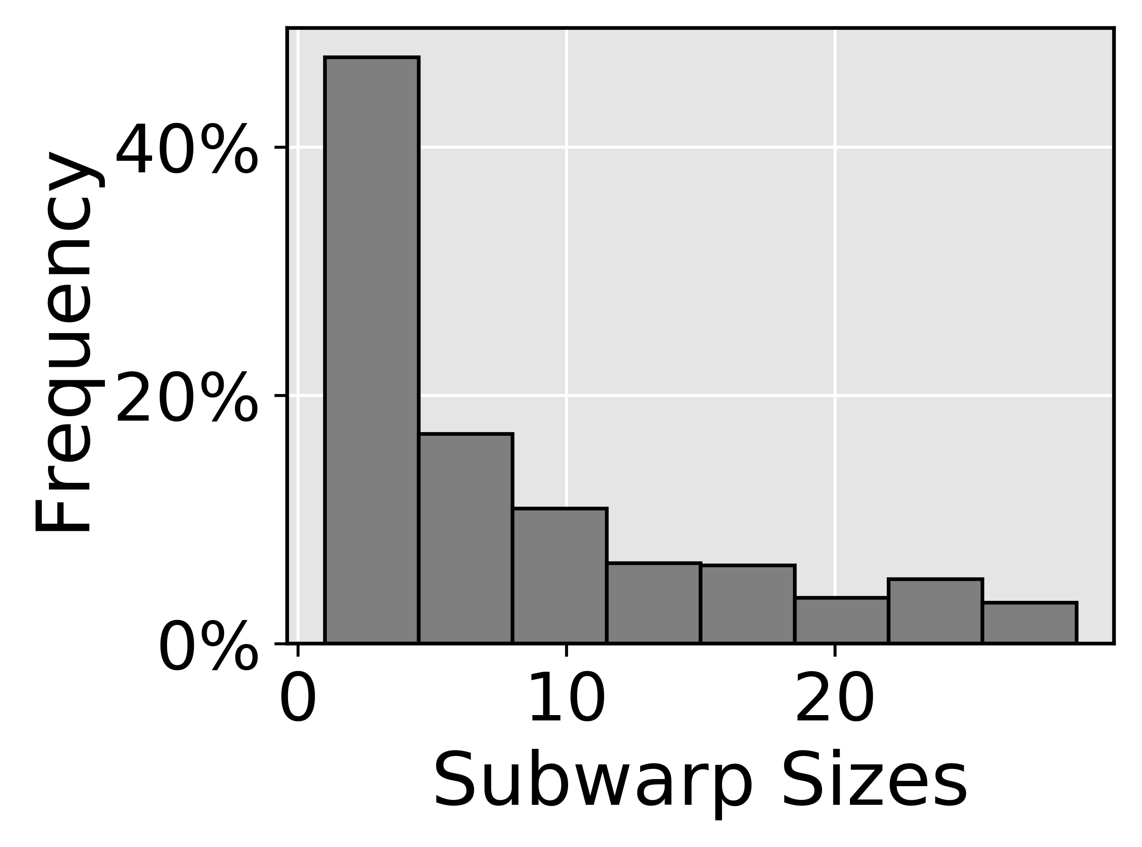
RCoal: Random Sized Subwarp (RSS)
Targets the deterministic nature of the coalescing mechanism
Fixed number of subwarps
Fixed sizes of subwarp
Deterministic mapping of the thread elements to subwarps
We select RSS with Skewed Distribution
Size distribution
RCoal to mitigate the correlation timing
attacks
RCoal to mitigate the correlation timing
attacks
✗
✓
Normal Distribution
Skewed Distribution
Mean of the distribution is same as FSS
Security and performance similar to FSS
Mean of the distribution is different than FSS
Large subwarp offers better coalescing
Improved security compared to FSS
Improved performance compared to FSS

Slide 59
RCoal: Random-Threaded Subwarp (RTS)
FSS: number of subwarps = 2
FSS+RTS: number of subwarps = 2
tid = 0
tid = 1
tid = 2
tid = 3
tid = 0
tid = 1
tid = 2
tid = 3
0x00
0x01
0x06
0x07
0x00
0x01
0x06
0x07
sid = 0
sid = 0
sid = 1
sid = 1
sid = 0
sid = 0
sid = 1
sid = 1
Coalescing Unit
Coalescing Unit
0x00
0x01
0x02
0x03
0x00
0x01
0x02
0x03
0x00
0x01
0x02
0x03
0x04
0x05
0x06
0x07
0x04
0x05
0x06
0x07
0x04
0x05
0x06
0x07

Slide 60
RCoal: Random-Threaded Subwarp (RTS)
RSS: number of subwarps = 2
RSS+RTS: number of subwarps = 2
sid = 0
sid = 1
sid = 0
sid = 1
tid = 0
tid = 1
tid = 2
tid = 3
tid = 2
tid = 0
tid = 1
tid = 3
0x00
0x01
0x06
0x08
0x06
0x00
0x01
0x08
Coalescing Unit
Coalescing Unit
0x00
0x01
0x02
0x03
0x00
0x01
0x02
0x03
0x00
0x01
0x02
0x03
0x04
0x05
0x06
0x07
0x04
0x05
0x06
0x07
0x08
0x09
0x0A
0x0B
0x08
0x09
0x0A
0x0B

Slide 61
Evaluation Set-up
AES-128
Plaintext with 32 lines
GPGPU-SIM
15 SMs, 32 threads/warp, one subwarp per coalescing unit (base case)
GDDR5 Memory with 6 MCs, 16 DRAM-banks, 4 bank-groups/MC
Enhanced Attack Algorithms
Corresponding Attacks

Slide 62
Security
(Lower the better)
Offers Security/Performance Trade-off
Execution Time
(Lower the better)
Notes:
Mention Rcoal in a BOX

Slide 63
Conclusions
We proposed RCoal, a set of three novel defense mechanisms
To mitigate the correlation timing attacks
Randomizes the memory access coalescing
Scales with the plaintext size (analysis in paper)
Theoretical analysis in the paper
RCoal offers a trade-off between security and performance and improves security at a modest performance loss.
Notes:
Try to reduce background and introduce rcoal_score

Slide 64
Future Work
Improving security at lower performance cost
Adding RCoal-like logic at other parts of the GPU hierarchy
Software-driven hints to the RCoal-like logic
Exploring the possibility of new attacks on GPUs
Bandwidth Management Techniques
Value approximation-based mechanisms
Unlocking new bandwidth sources in GPUs

Slide 65
Acknowledgements
Mohamed Ibrahim (Ph.D. Student)
Gurunath Kadam
(Ph.D. student)
Hongyuan Liu
(Ph.D. student)
Haonan Wang
(Ph.D. student)
Fan Luo
(MS student, graduated)
Thank you!
Questions?
(Email: adwait@cs.wm.edu)
Adwait Jog
(Faculty)
More details: http://insight-archlab.github.io/

Slide 66
Memory Bandwidth Management for Enhanced Throughput and Security in GPUs
Adwait Jog
Assistant Professor of Computer Science
College of William & Mary
http://adwaitjog.github.io/

Slide 67
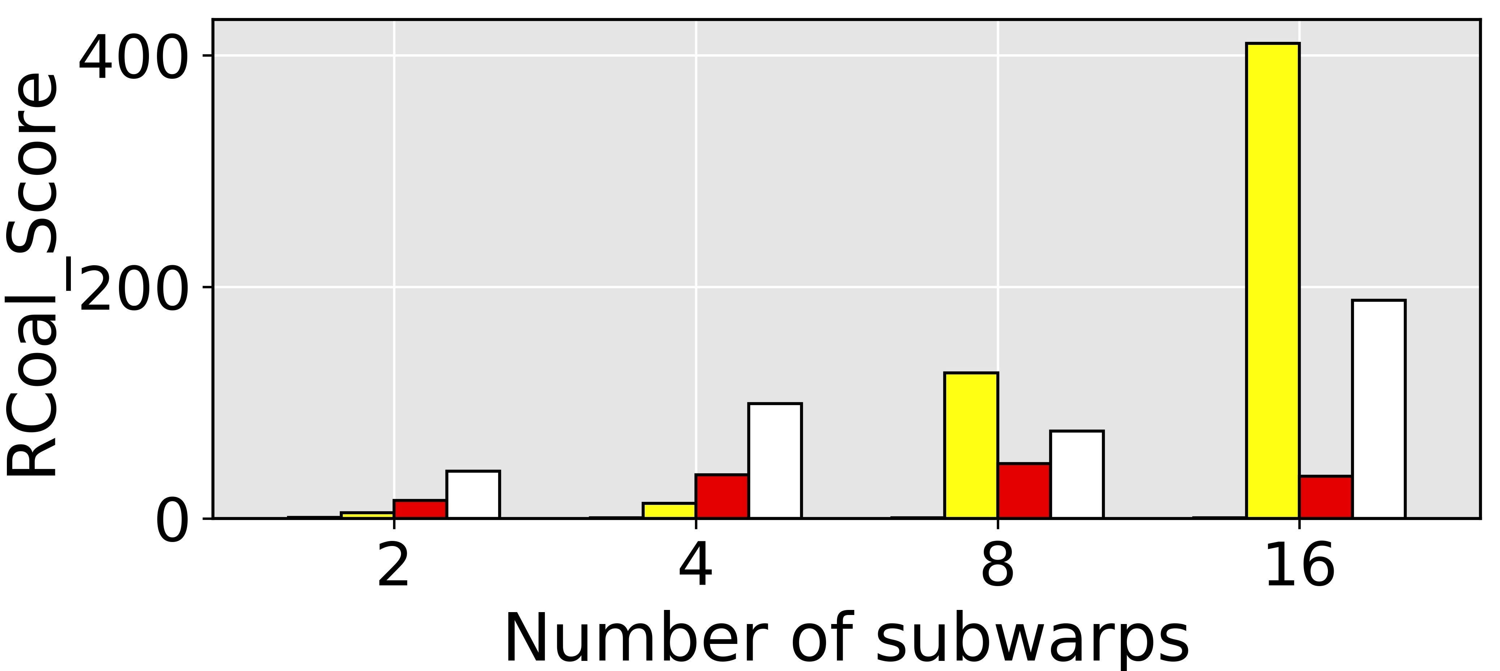
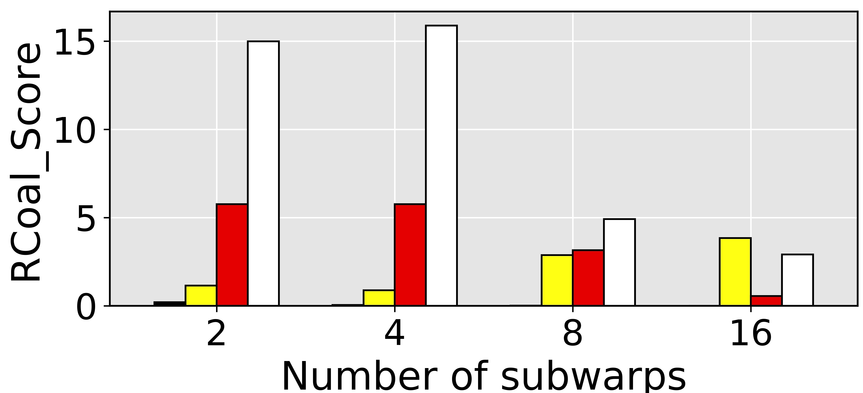
RCoal_Score
$$RCoal_Score=\frac{S^{a}}{{execution_time}^{b}}$$
Security Oriented (a=1, b=1)
Performance Oriented (a=1, b=20)

Slide 68
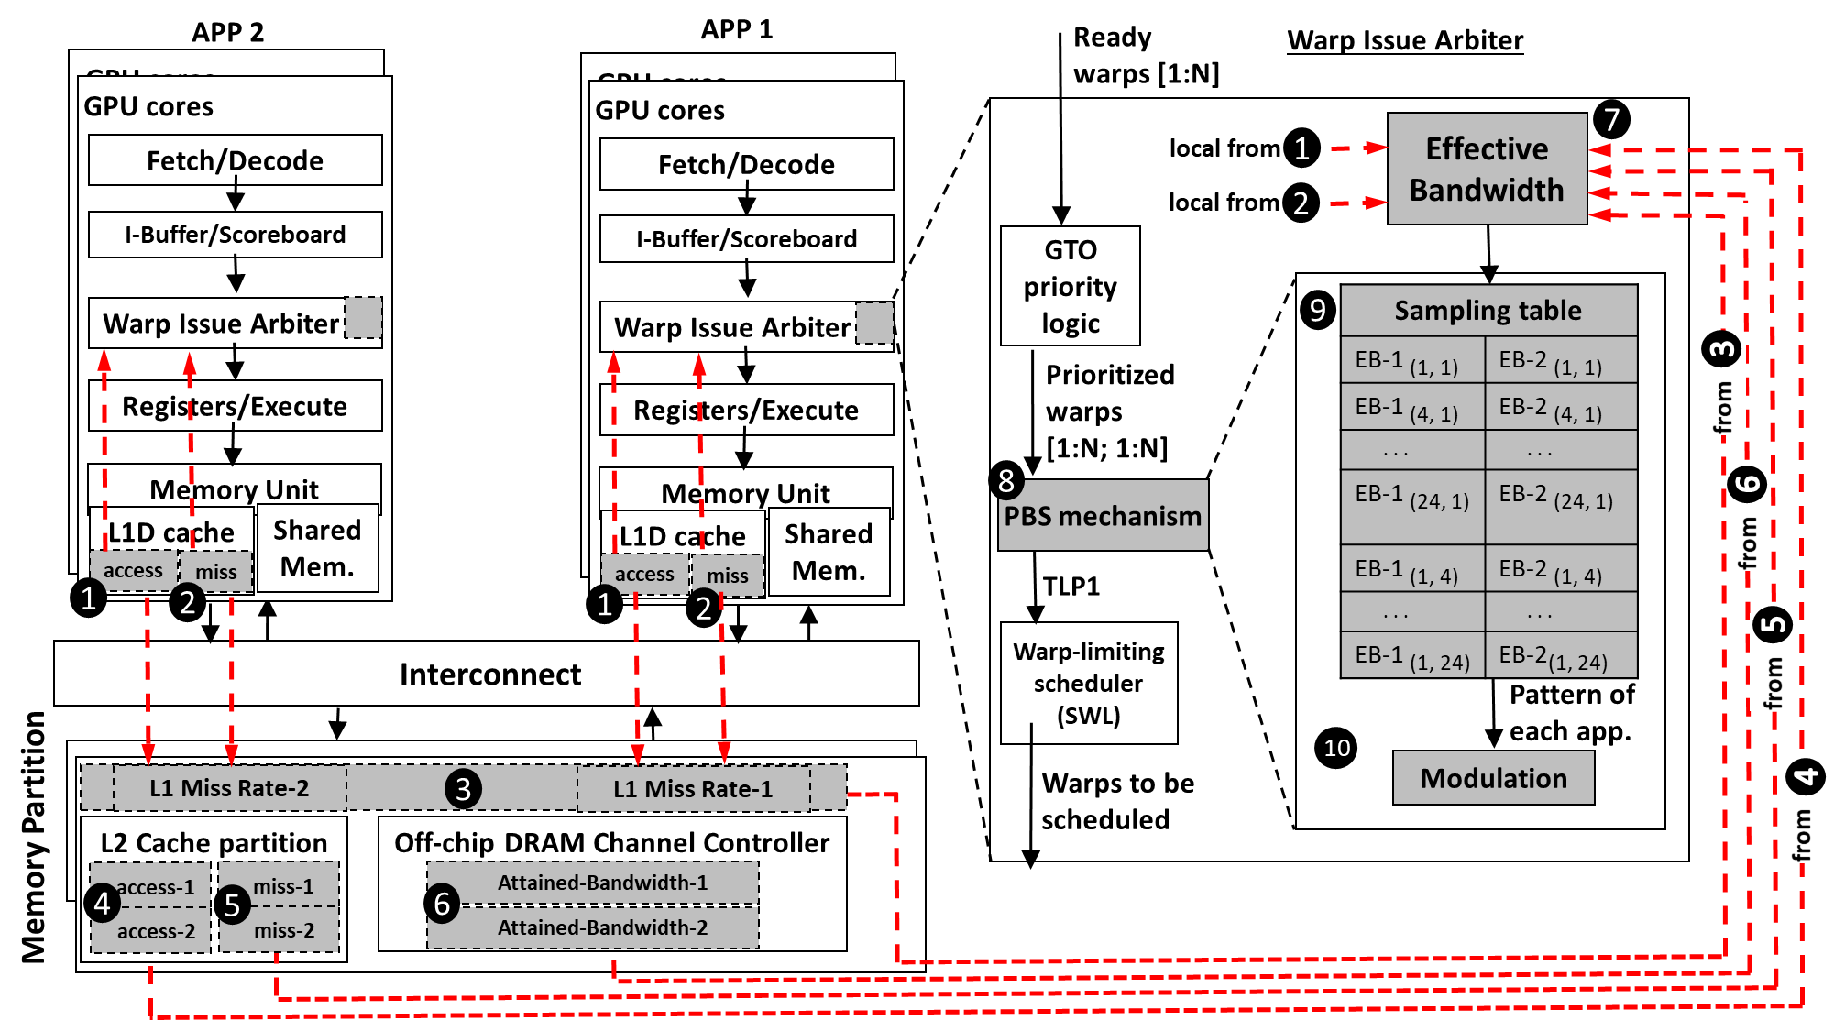
Implementation & Overhead

Slide 69
Evaluation – Case Studies
Core Partitioning
PBS enhances WS and FI under both equal and unequal core partitioning scenarios
PBS benefits reduce with unequal partitioning because with different core partitioning each application executes with a different amount of TLP
Core partitioning techniques do not completely solve the interference problem and PBS can provide additional benefits
Notes:
Explain Unequal partitioning?
We test PBS under two different core partitioning scenarios: 2:1 and 1:2 partitioning (e.g., in 2:1, the first and the second applications are assigned 20 and 10 cores, respectively) and compare it to our baseline that allocates 15 cores to each application. Figure shows the benefits of PBS over ++bestTLP observed in WS and FI averaged across all our 50 workloads. The bar denoted by Equal represents the average improvement of PBS with equal partitioning, and the bar denoted by Unequal represents the average improvement of PBS with the best performing partitioning scheme among 2:1 and 1:2 (found separately for each workload and then averaged). PBS enhances WS, FI, and HS under both equal and unequal core partitioning scenarios, compared to ++bestTLP. However, the benefits of PBS reduce with unequal partitioning because with different core partitioning each application executes with a different amount of TLP. As we choose the best (among 2:1 and 1:2) core partitioning configuration, the interference is also alleviated because of core partitioning itself in addition to our TLP management schemes. As the design of core partitioning is itself an interesting and non-trivial research problem, we conclude that these techniques still do not completely solve the interference problem and TLP management techniques like PBS can provide additional benefits.

Slide 70
Evaluation – Case Studies
Cache Partitioning
PBS improves WS and FI under both Shared and Equal scenarios
Cache partitioning can alleviate the interference at L2
Cache partitioning might be suboptimal (underutilization) when different applications utilize the caches differently
Notes:
Explain Shared vs. Equal?
Figure shows the benefits of PBS when the L2 is way-partitioned equally (denoted by Equal) across two applications, and compare it to our baseline where the L2 cache is shared (denoted by Shared). We observe that PBS improves all three metrics (WS, FI, and HS) under both the scenarios. Cache partitioning can alleviate the interference at L2, but it might be suboptimal in scenarios where different applications in the same workload utilize the caches differently. This might lead to a portion of the cache to be not utilized well. On the other hand, PBS changes the cache demand of each application by TLP modulation.

Slide 71
GPUs – A Closer Look
SIMT Cores
…
W
W
W
W
W
W
Threads
Scheduler
Interconnect
Warp Scheduler
L1 Caches
SIMT
Lanes
GPU
Memory
Warps
L2 cache
GPU
Memory
L2 cache
…

Slide 72
Working Philosophy
Execution in a SIMT Core
W3
Computation
W2
Waiting for Data from GPU Memory
W1
GPU attempts to hide long memory latency with computation from
other thread warps

Slide 73
Bandwidth Challenge
GPUs are under-utilized
55%
GPGPU Applications
Percentage of total execution cycles wasted waiting for the data to come back from memory ➔ Memory Bandwidth is the primary bottleneck

Slide 74
RCoal Security Enhancement
Except FSS, all defense mechanisms show improvement in the security
RSS based mechanisms generally offer better security
Theoretically 24x to 961x improvement (detailed analysis in paper)
No coalescing,
No correlation

Slide 75
RCoal Performance
Performance suffers as number of subwarp increase
RSS offers better performance as compared to FSS
RTS does not affect the performance

